Slide 1
Predicting Crab Age with Machine Learning
🦀 Justin Heng, Brian Lucero 🦀

Slide 2
Abstract
Machine learning can be used to predict the age of crabs.
It can be more accurate than simply weighing a crab to estimate its age.
Several different models can be used, though support vector regression was found to be the most accurate in this experiment.

Slide 3
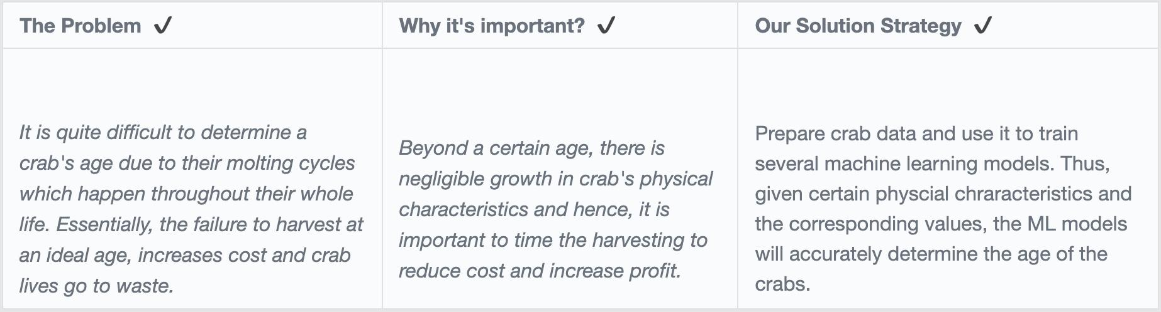
Introduction

Slide 4
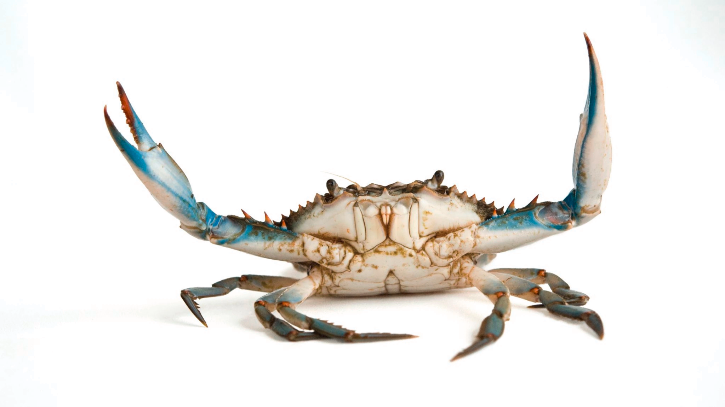
Background
Assume that a crab is mature and ready to harvest after 12 months
Ignore other features that affect a crab's harvestability such as egg laying crabs
Predict age rather than weight since machine learning is more applicable (pointless to predict weight)

Slide 5
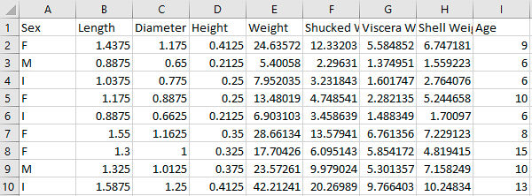
Dataset
dataset from Kaggle
over 1000 samples and nine features each
"Sex", "Length", "Diameter", "Height", "Weight", "Shucked Weight", "Viscera Weight", "Shell Weight", and "Age"

Slide 6
Data Preprocessing
Converting sex to numerical values
Male = 1
Female = 2
Indeterminate = 1.5
Test train split
X_train, X_test, y_train, y_test = train_test_split(X, y, test_size=0.3, random_state=132)

Slide 7
Feature Selection
Pearson correlation coefficients
Ignore sex and keep all the other features
> 0.5 is very high correlation
SexValue | 0.0337
Length | 0.555
Diameter | 0.574
Height | 0.552
Weight | 0.539
Shucked Weight | 0.419
Viscera Weight | 0.501
Shell Weight | 0.625
Table 1. Pearson correlation coefficients

Slide 8
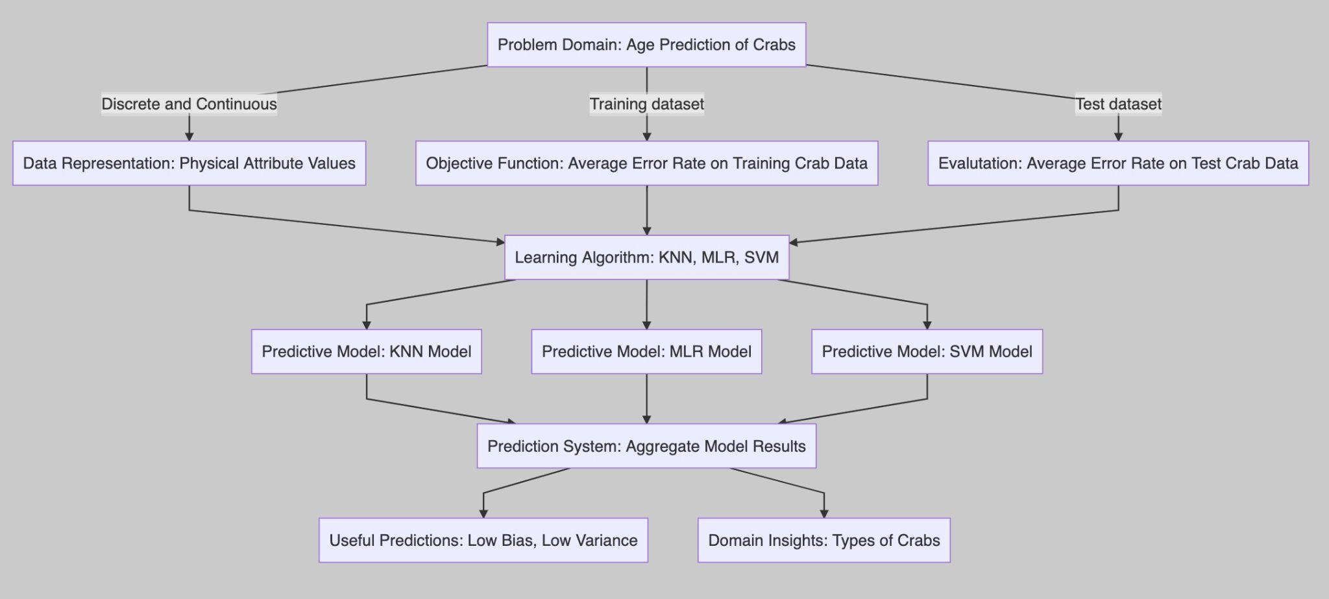
Methodology

Slide 9
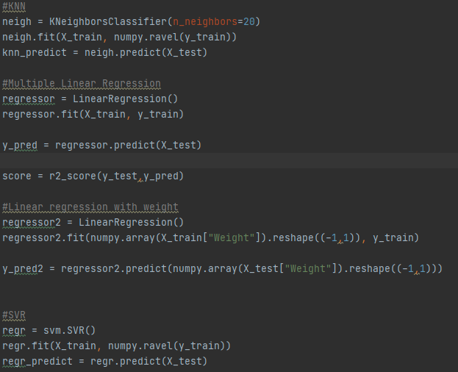
Methodology
3 machine learning models and 1 baseline model
Simple linear regression of Weight vs Age (baseline)
K-nearest neighbor (ML)
Multiple Linear Regression (ML)
Support Vector Regression (ML)
Scikit Learn Python libraries

Slide 10
Methodology (MLR)
Data
Feature Selection
Removed gender
Train-Test Split
Train model
Evaluate results
Measure Average Error
Training Set (70)
Test Set (30)

Slide 11
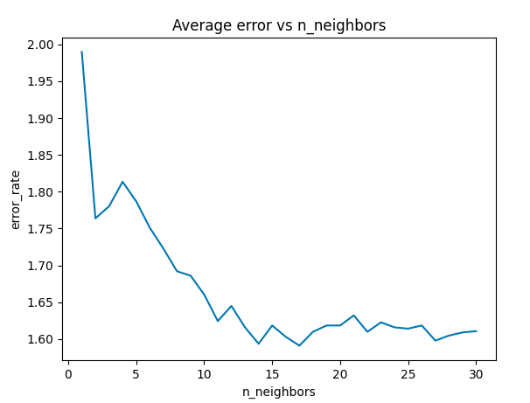
Methodology (Knn)
Need to find what value to use for k
Average error for 0 < k < 30
We will use k = 20

Slide 12
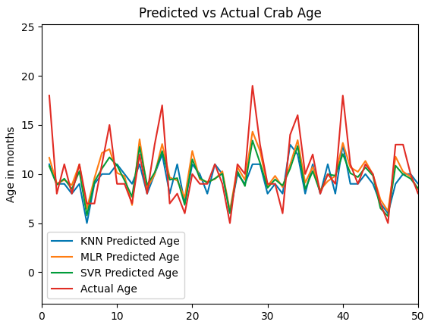
Results

Slide 13
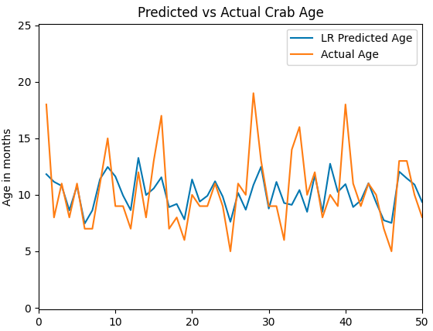
Results (Baseline)
Linear regression
Only uses weight to determine age
Average error: 1.9 months

Slide 14
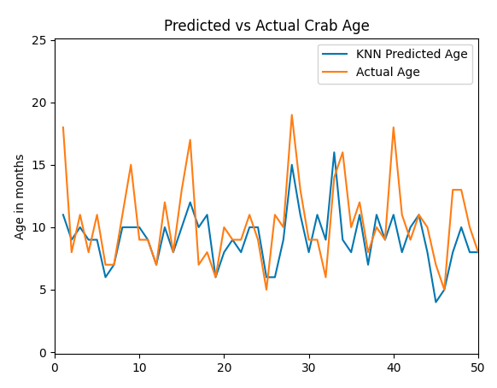
Results (Knn)
Outperformed the baseline
Slightly the worst out of the three ML models
Not as accurate at predicting ages under 12 months
Average error: 1.6 months

Slide 15
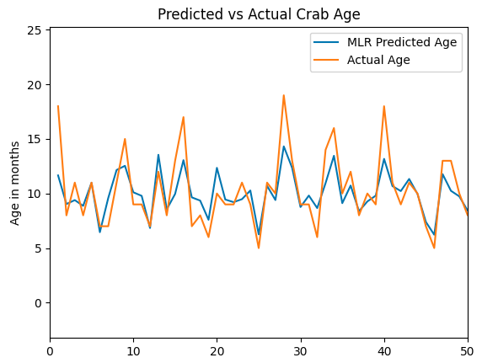
Results (Multiple Linear Regression)
Outperformed the baseline
Better at predicting mature ages above 12 months
Overall, a good model
Average error: 1.5 months

Slide 16
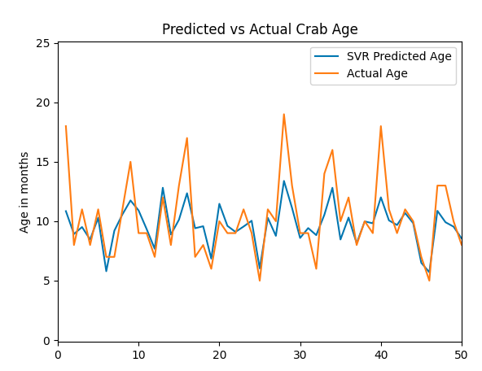
Results (Support Vector Regression)
Outperformed the baseline
Accurate at predicting ages under 12 months
Had the least amount of error
Average error: 1.4 months

Slide 17
Results
Model | Type | Error (months)
Linear Regression (Weight vs Age) | Baseline | 1.939
K-nearest Neighbor | ML | 1.610
Multiple Linear Regression | ML | 1.560
Support Vector Regression | ML | 1.471

Slide 18
Conclusion
Machine learning outperformed simple linear regression
On average, the models had an error of about 1.5 months compared to 2.0 months
Support vector regression had a slight lead, but multiple linear regression and k-nearest neighbor were good predictors as well
Predictions were good up until 12 months when the crabs reached full maturity

Slide 19
References
[1] https://www.kaggle.com/datasets/sidhus/crab-age-prediction
[2] https://scikit-learn.org/stable/modules/svm.html
[3] https://repository.library.noaa.gov/view/noaa/16273/noaa_16273_DS4.pdf
[4] https://faculty.math.illinois.edu/~hildebr/tex/latex-start.html
[5] https://github.com/krishnaik06/Multiple-Linear-Regression
[6] https://github.com/13rianlucero/CrabAgePrediction

